Slide 1
Kishore Kumar K
Final Project
3/21/2024 Annual Review

Slide 2
Long-Term Stock Market Prediction Incorporating Economic Indicators and Sentiment Analysis
3/21/2024 Annual Review

Slide 3


AGENDA
1 . Introduction
2 . Data Collection and Preprocessing
3 . Model Development
4 . Results and Analysis
5. Discussion and Conclusions
3/21/2024 Annual Review

Slide 4

PROBLEM STATEMENT
"In an era where financial markets are increasingly influenced by both macroeconomic factors and investor sentiment expressed through various channels, there exists a critical need to develop a robust methodology for long-term stock market prediction. This project aims to address this need by investigating the integration of economic indicators and sentiment analysis techniques to accurately forecast stock market movements over an extended time horizon. By leveraging advanced statistical and machine learning models, the study seeks to provide actionable insights for investors, analysts, and policymakers, ultimately enhancing decision-making processes in the realm of financial markets."
3/21/2024 Annual Review

Slide 5

PROJECT OVERVIEW
"Our project focuses on developing a comprehensive framework for forecasting stock market trends over extended periods by synergizing the insights derived from economic indicators and sentiment analysis. In an increasingly interconnected and information-driven financial landscape, understanding the interplay between macroeconomic factors and investor sentiment is paramount for making informed investment decisions. Our approach involves gathering and analyzing a diverse array of economic indicators, ranging from GDP growth and inflation rates to employment figures and consumer sentiment indices, to capture the underlying fundamentals driving market dynamics. Additionally, we employ sophisticated sentiment analysis techniques to extract actionable insights from textual dates such as news articles, social media, and financial reports, thereby quantifying the collective mood and sentiment of market participants. By integrating these two streams of information through advanced statistical and machine learning models, we aim to enhance the accuracy and robustness of long-term stock market predictions.
3/21/2024 Annual Review

Slide 6

WHO ARE THE END USERS?
1. Investors :
Individual investors seeking to make informed decisions about their investment portfolios.
2. Financial Analysts :
Market analysts and research professionals interested in gaining deeper insights into long-term market trends and factors influencing asset price.
3. Policy Makers :
Government agencies and policymakers tasked with formulating economic policies and regulatory measures aimed at stabilizing financial markets and promoting economic growth.
4. Risk Managers :
Risk management professionals responsible for assessing and mitigating financial risks within organizations, including market risk stemming from fluctuations in asset prices and economic conditions.
3/21/2024 Annual Review

Slide 7

YOUR SOLUTION AND ITS VALUE PROPOSITION
The solution for the project on long-term stock market prediction incorporating economic indicators and sentiment analysis involves developing an integrated framework that combines the power of economic indicators and sentiment analysis to provide accurate and actionable forecasts of stock market movements.
3/21/2024 Annual Review

Slide 8
Value Propositions
Enhanced Predictive Accuracy :
By leveraging a diverse set of economic indicators and sentiment analysis techniques, our solution aims to improve the accuracy of long-term stock market predictions, enabling investors and analysts to make more informed decisions.
2. Comprehensive Insights :
Our approach provides a holistic view of market dynamics by incorporating both macroeconomic fundamentals and investor sentiment, allowing users to gain deeper insights into the underlying factors driving market trends.
3. Timely Decision Support :
With real-time data collection and analysis capabilities, our solution enables users to stay ahead of market developments and respond quickly to changing conditions, thereby enhancing their ability to capitalize on investment opportunities and mitigate risks.

Slide 9

THE WOW IN YOUR SOLUTION
The "wow" factor in our solution lies in seamlessly blending economic indicators and sentiment analysis into a unified framework. Here's why it's impressive:
1. Synergistic Fusion 2. Dynamic Adaptability
3. Predictive Power
4. Intuitive Visualization
5. Value-added Insights
6. Empirical Validation
In short, our solution offers a transformative approach to stock market prediction, empowering users with accurate insights and decision support tools for confident investment decisions.
3/21/2024 Annual Review
9

Slide 10
MODELLING
1. Data Prep :
Clean and integrate economic indicators and sentiment data.
2. Feature Eng :
Create features and select the most informative ones.
3. Modeling :
Explore ARIMA, SARIMA, Random Forests, and Gradient Boosting.
4. Ensemble :
Combine models for better accuracy.
5. Tuning :
Optimize model parameters.
6. Evaluation :
Assess performance with metrics like MAE, MSE, RMSE.
3/21/2024 Annual Review
10

Slide 11
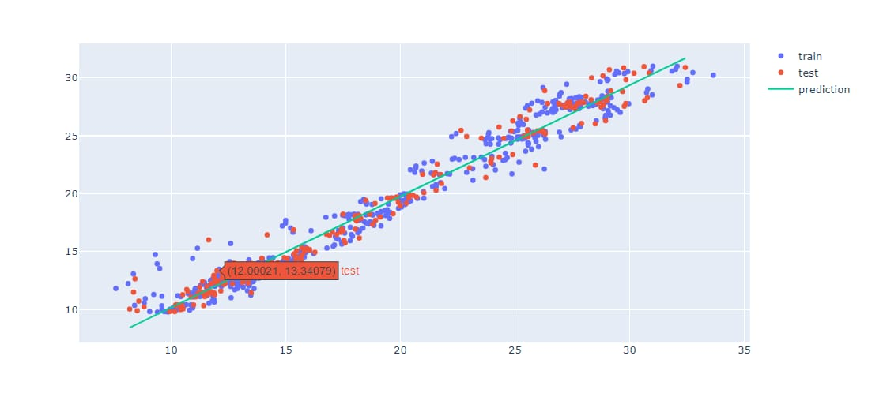
RESULTS
3/21/2024 Annual Review
11

